Slide 1
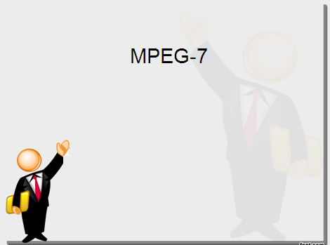

Image Enhancement Using Spatial Filtering
Kiran TALELE
 99 870 30 881

Slide 2
Kiran TALELE
@ Bharatiya Vidya Bhavans’ Sardar Patel Institute of Technology Andheri(w) Mumbai
Associate Professor, Electronics Engineering Department (1997)
Dean, Students, Alumni & External Relations (2022)
@ Sardar Patel Technology Business Incubator(SP-TBI),
Funded by Department of Science & Technology(DST),
Govt. of India
Head, Academic Relations (2015)
@ IEEE Bombay Section
Treasurer (2020)
Executive Committee Member (2015)
Kiran TALELE
2

Slide 3
Image Enhancement by Neighbourhood Processing : Spatial Filtering
(i) In Neighbourhood opération, Tx. function works on a group of input pixel values
(ii) The Output pixel value at (x,y) position is obtained by masking operation
(iii) The use of spatial mask for image processing is called spatial filtering and the mask is called spatial filter
Kiran TALELE
3

Slide 4
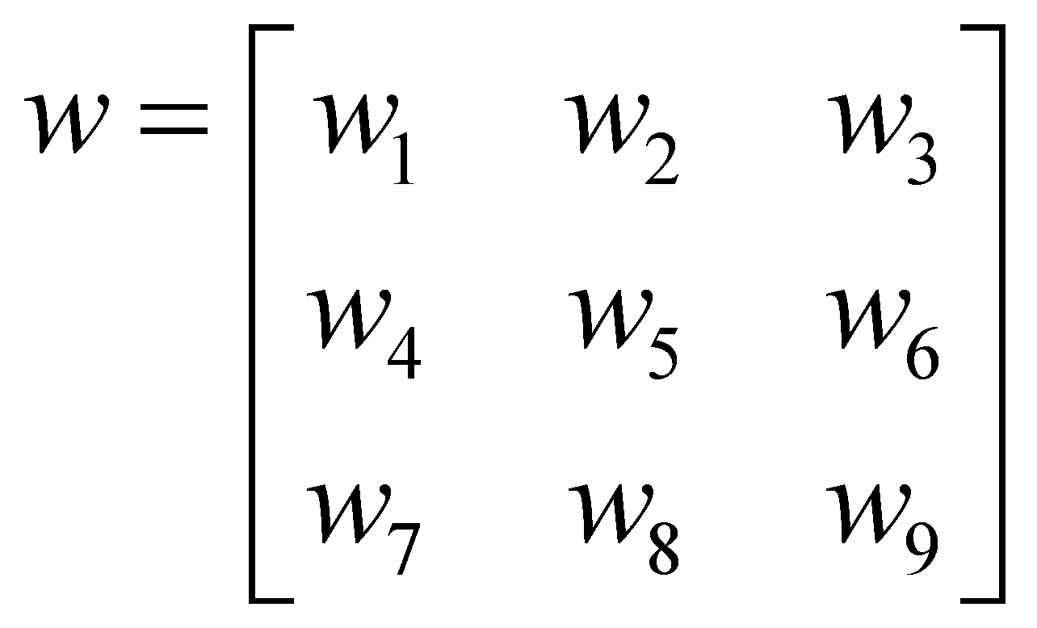
Masking Operation: Consider an image F and filter mask W
F=
Z₁ | Z₂ | Z₃
Z₄ | Z₅ | Z₆
Z₇ | Z₈ | Z₉
A =
 | R
*
The response of mask is given by,
R = z₁ w₁ + z₂ w₂ + z₃ w₃ + … + z₉ w₉
Kiran TALELE
4

Slide 5
Spatial Filtering
F
Spatial filter
A
O 1 2 3 4 5 6 7 8 9 10 11
y
O 1 2 3 4 5 6 7 8 9 10 11
y
O
1
2
3
4
5
6
7
8
9
O
1
2
3
4
5
6
7
8
9
Simple 3*3 Neighbourhood
x
Input Image F
x
Output Image A

Slide 6
Spatial Filtering
F(8,11)
O 1 2 3 4 5 6 7 8 9 10 11
y
O
1
2
3
4
5
6
7
8
z₁
z₂
z₃
w₁
w₂
w₃
z₄
z₅
z₆
*
w₄
w₅
w₆
z₇
z₈
z₉
w₇
w₈
w₉
Original Image Pixels
Filter Mask
The response of Filter at A(8,11) position is given by,
A(8,11) = z₁ w₁ + z₂ w₂ +
z₃ w₃+ … + z₉ w₉
x
Input Image F
The above is repeated for every pixel in the original image to generate the smoothed image

Slide 7
List of Spatial Filters
[I] Smoothing Linear Filters (3)
Eg. Low Pass Averaging Filter, Weighted Average Filter, Trimmed Averaging Filter and Geometric Mean Filter
[II] Smoothing Non-Linear Filters (3)
Eg. Median, Max and Min Filter.
[III] Sharpening : First Order Derivative Filters (4)
Eg. Robert, Prewit, Sobel and Fri-Chen filter
[IV] Sharpening Second Order Derivative Filters (3)
Eg. Laplacian Filter, HPF and High Boost Filter
Kiran TALELE
7

Slide 8
[ I ] Smoothing Linear Filters
(1) Low Pass Averaging Filter
(i) LPF attenuates High frequency Components and allows to pass LOW frequency components of the image.
(ii) LPF reduces the difference between neighbouring pixels by distributing its’ energy using averaging technique.
Kiran TALELE
8

Slide 9
(iii) LPF removes sharp transitions in the image
Sharp transitions are due to :
(1) High frequency random Impulse Noise.
(2) High frequency Edges of an object.
.
.
.
Kiran TALELE
9

Slide 10
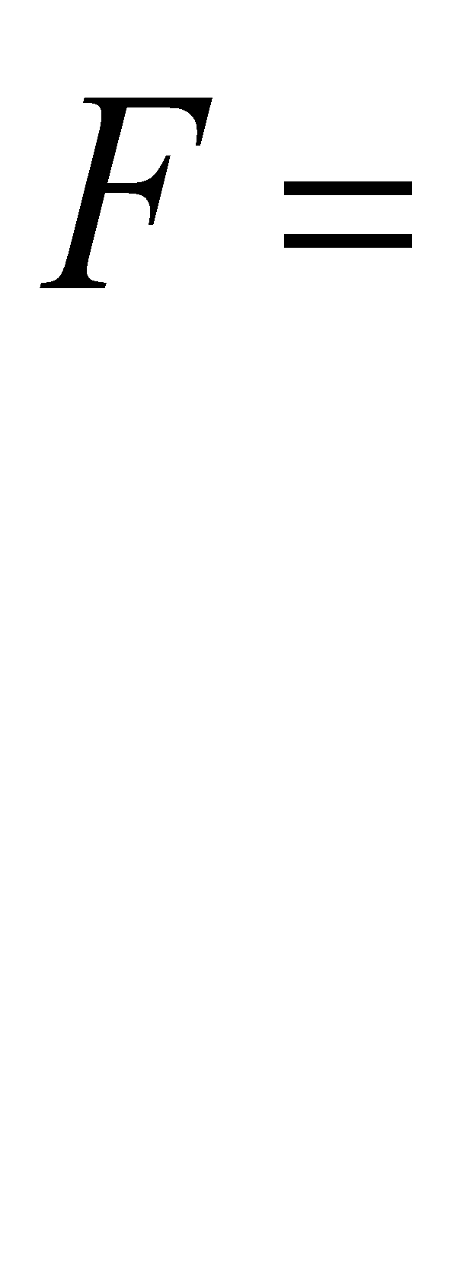
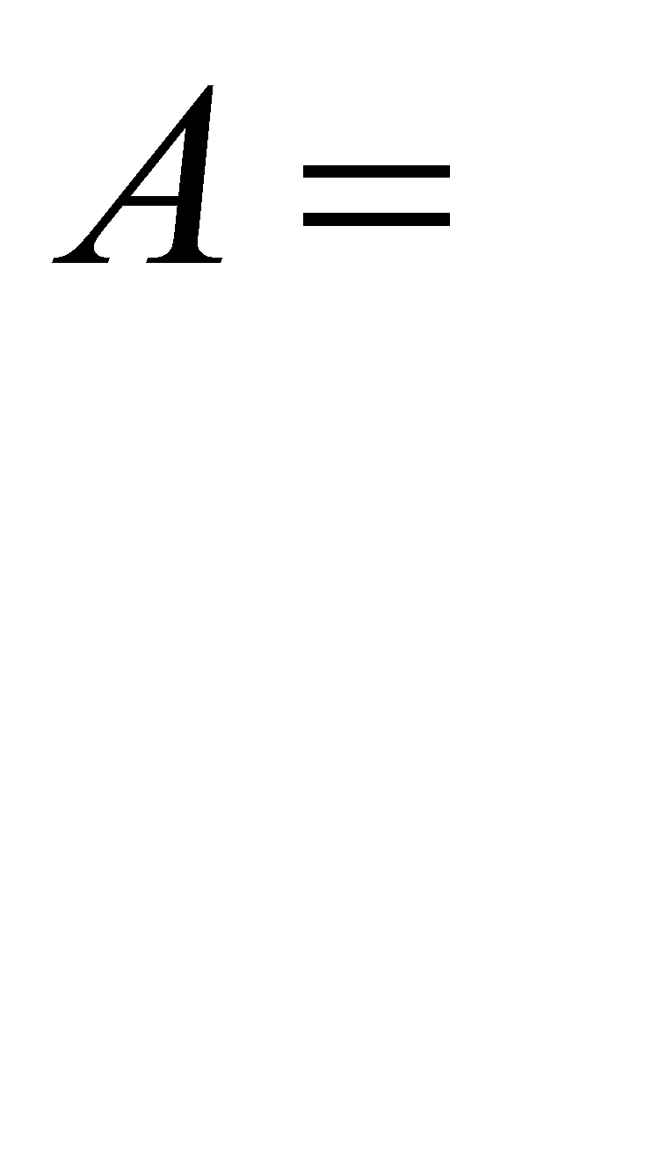
Eg. Consider a Digital Image F with impulse noise
0 | 0 | 0
0 | 200 | 0
0 | 0 | 0
L P F
(IV) LPF reduces the difference between the neighbouring pixels by distributing its energy in all directions by averaging techniques
(v) The net effect of LP filtering is Image Blurring
Kiran TALELE
10

Slide 11
Eg. Digital Image with impulse noise
0 | 0 | 0
0 |  | 0
0 | 0 | 0
 | 22
22 |  | 22
22 | 22 | 22
22 | 22 | 22
L P F
200
LPF reduces the difference between the neighbouring pixels by distributing its energy in all directions by averaging techniques
Kiran TALELE
11

Slide 12
Eg-1 : Digital Image with impulse noise
0 | 1 | 2
7 | 255 | 3
6 | 5 | 4
L P F
Case-1 : Assume virtual Rows and Columns with Zero pixel
Values
0 | 0 | 0 | 0 | 0
0 | 0 | 1 | 2 | 0
0 | 7 | 255 | 3 | 0
0 | 6 | 5 | 4 | 0
0 | 0 | 0 | 0 | 0
L P F

Slide 13
Eg-1 : Digital Image with impulse noise
0 | 1 | 2
7 | 255 | 3
6 | 5 | 4
L P F
0 | 0 | 0 | 0 | 0
0 | 0 | 1 | 2 | 0
0 | 7 | 255 | 3 | 0
0 | 6 | 5 | 4 | 0
0 | 0 | 0 | 0 | 0
L P F
Kiran TALELE
13

Slide 14
Eg-1 : Digital Image with impulse noise
0 | 1 | 2
7 | 255 | 3
6 | 5 | 4
L P F
0 | 0 | 0 | 0 | 0
0 | 0 | 1 | 2 | 0
0 | 7 | 255 | 3 | 0
0 | 6 | 5 | 4 | 0
0 | 0 | 0 | 0 | 0
L P F
31
Kiran TALELE
14

Slide 15
Eg-1 : Digital Image with impulse noise
0 | 1 | 2
7 | 255 | 3
6 | 5 | 4
L P F
0 | 0 | 0 | 0 | 0
0 | 0 | 1 | 2 | 0
0 | 7 | 255 | 3 | 0
0 | 6 | 5 | 4 | 0
0 | 0 | 0 | 0 | 0
29
L P F
31
Kiran TALELE
15

Slide 16
Eg-1 : Digital Image with impulse noise
0 | 1 | 2
7 | 255 | 3
6 | 5 | 4
L P F
0 | 0 | 0 | 0 | 0
0 | 0 | 1 | 2 | 0
0 | 7 | 255 | 3 | 0
0 | 6 | 5 | 4 | 0
0 | 0 | 0 | 0 | 0
29
30
L P F
31
Kiran TALELE
16

Slide 17
Eg-1 : Digital Image with impulse noise
0 | 1 | 2
7 | 255 | 3
6 | 5 | 4
L P F
0 | 0 | 0 | 0 | 0
0 | 0 | 1 | 2 | 0
0 | 7 | 255 | 3 | 0
0 | 6 | 5 | 4 | 0
0 | 0 | 0 | 0 | 0
29
30
30
L P F
31
Kiran TALELE
17

Slide 18
Eg-1 : Digital Image with impulse noise
0 | 1 | 2
7 | 255 | 3
6 | 5 | 4
L P F
0 | 0 | 0 | 0 | 0
0 | 0 | 1 | 2 | 0
0 | 7 | 255 | 3 | 0
0 | 6 | 5 | 4 | 0
0 | 0 | 0 | 0 | 0
29
30
30
L P F
30
31
Kiran TALELE
18

Slide 19
Eg-1 : Digital Image with impulse noise
0 | 1 | 2
7 | 255 | 3
6 | 5 | 4
L P F
0 | 0 | 0 | 0 | 0
0 | 0 | 1 | 2 | 0
0 | 7 | 255 | 3 | 0
0 | 6 | 5 | 4 | 0
0 | 0 | 0 | 0 | 0
29
30
30
L P F
30
31
Kiran TALELE
19

Slide 20
Eg-1 : Digital Image with impulse noise
0 | 1 | 2
7 | 255 | 3
6 | 5 | 4
L P F
0 | 0 | 0 | 0 | 0
0 | 0 | 1 | 2 | 0
0 | 7 | 255 | 3 | 0
0 | 6 | 5 | 4 | 0
0 | 0 | 0 | 0 | 0
29
30
30
L P F
30
31
30
Kiran TALELE
20

Slide 21
Eg-1 : Digital Image with impulse noise
0 | 1 | 2
7 | 255 | 3
6 | 5 | 4
L P F
0 | 0 | 0 | 0 | 0
0 | 0 | 1 | 2 | 0
0 | 7 | 255 | 3 | 0
0 | 6 | 5 | 4 | 0
0 | 0 | 0 | 0 | 0
29
30
30
L P F
30
31
30
30
Kiran TALELE
21

Slide 22
Eg-1 : Digital Image with impulse noise
0 | 1 | 2
7 | 255 | 3
6 | 5 | 4
L P F
0 | 0 | 0 | 0 | 0
0 | 0 | 1 | 2 | 0
0 | 7 | 255 | 3 | 0
0 | 6 | 5 | 4 | 0
0 | 0 | 0 | 0 | 0
29
30
30
L P F
30
31
30
30
33
Kiran TALELE
22

Slide 23
Eg-1 : Digital Image with impulse noise
0 | 1 | 2
7 | 255 | 3
6 | 5 | 4
L P F
0 | 0 | 0 | 0 | 0
0 | 0 | 1 | 2 | 0
0 | 7 | 255 | 3 | 0
0 | 6 | 5 | 4 | 0
0 | 0 | 0 | 0 | 0
 |  | 30
30 | 33
29
30
30
L P F
30
31
30

Slide 24
Eg-2 : Consider a Digital Image with impulse noise
0 | 1 | 2
7 | 255 | 3
6 | 5 | 4
L P F
0 | 0 | 0 | 0 | 0
0 | 0 | 1 | 2 | 0
0 | 7 | 255 | 3 | 0
0 | 6 | 5 | 4 | 0
0 | 0 | 0 | 0 | 0
29
30
30
L P F
30
31
30
30
33
30
Kiran TALELE
24

Slide 25
0 | 1 | 2
7 | 255 | 3
6 | 5 | 4
29
30
30
L P F
30
31
30
30
33
30
All the pixel in the neighourhood of impulse noise have almost same value.
Thus high frequency impulse noise is completely suppressed in the output image.
Kiran TALELE
25

Slide 26
Digital Image with impulse noise
0 | 1 | 2
7 | 255 | 3
6 | 5 | 4
30 | 30 | 30
32 | 31 | 31
34 | 33 | 32
L P F
Case-2 : Assume Virtual Rows and Columns with repeated border pixel Values
0 | 0 | 1 | 2 | 2
0 | 0 | 1 | 2 | 2
7 | 7 | 255 | 3 | 3
6 | 6 | 5 | 4 | 4
6 | 6 | 5 | 4 | 4
30 | 30 | 30
32 | 31 | 31
34 | 33 | 32
L P F

Slide 27
Eg-2. Digital Image with High Frequency Edge
10 | 10 | 200 | 200
10 | 10 | 200 | 200
10 | 10 | 200 | 200
10 | 73 | 137 | 200
10 | 73 | 137 | 200
10 | 73 | 137 | 200
.
10 | 10 | 200 | 200
10 | 10 | 200 | 200
10 | 10 | 200 | 200
200 | 200
200 | 200
200 | 200
L P F
L P F
10 | 10 | 10 | 200 | 200 | 200
10 | 10 | 10 | 200 | 200 | 200
10 | 10 | 10 | 200 | 200 | 200
10 | 10 | 10 | 200 | 200 | 200
10 | 10 | 10 | 200 | 200 | 200
 | 10 | 73 | 137 | 200
 | 10 | 73 | 137 | 200
 | 10 | 73 | 137 | 200
Kiran TALELE
27

Slide 28
Summary :
All the pixels in the output image have almost same value.
Averaging of gray values in the neighbourhood reduces the sharp transitions in the images.
Thus High frequency Impulse noise is completely suppressed. This is desirable effect.
However high frequency edges are blurred.
This is undesired effect.
Kiran TALELE
28

Slide 29
Derivation of LPF Mask
Consider a Digital Image F and LPF Mask w as shown in figure below,
Z₁ | Z₂ | Z₃
Z₄ | Z₅ | Z₆
Z₇ | Z₈ | Z₉
L P F
w₁ | w₂ | w₃
w₄ | w₅ | w₆
w₇ | w₈ | w₉
The response of LPF mask at (x,y) position is given by,
R = z₁ w₁ + z₂ w₂ + z₃ w₃ + … + z₉ w₉ ……(I)
Kiran TALELE
29

Slide 30
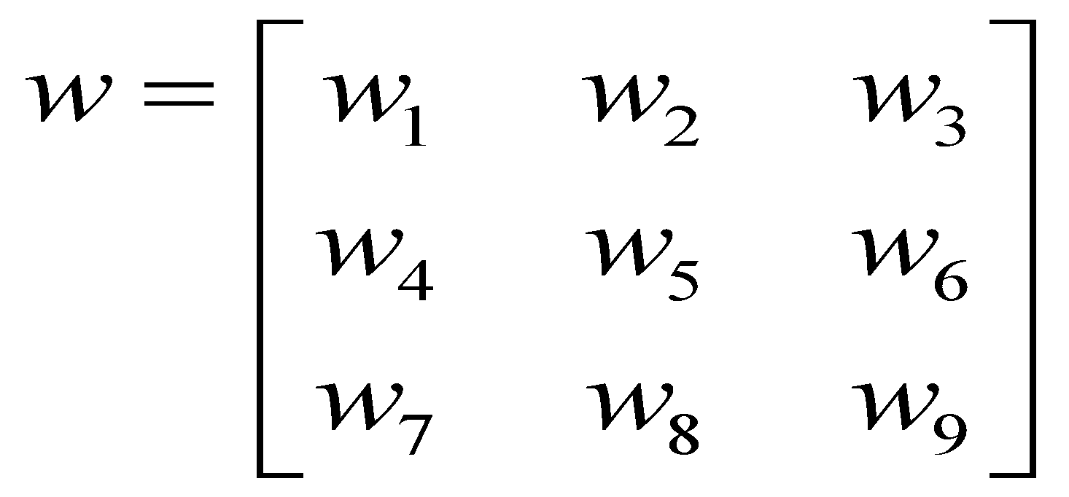
Consider a Digital Image F and LPF Mask w as shown in figure below,
Z₁ | Z₂ | Z₃
Z₄ | Z₅ | Z₆
Z₇ | Z₈ | Z₉
L P F
 | R
The response of LPF mask at A(x,y) position is given by,
R = z₁ w₁ + z₂ w₂ + z₃ w₃ + … + z₉ w₉ ……(I)
Kiran TALELE
30

Slide 31
Z₁ | Z₂ | Z₃
Z₄ | Z₅ | Z₆
Z₇ | Z₈ | Z₉
L P F
 | R
By averaging output pixel value at (x,y) position is given by,
R = ( z₁ + z₂ + z₃ + … + z₉ )
R = z₁ z₁ + z₂ + + … + z₉ ) …… (II)
Kiran TALELE
31

Slide 32
R = z₁ w₁ + z₂ w₂ + z₃ w₃ + … + z₉ w₉ ……(I)
R = z₁ z₁ + z₂ + + … + z₉ …… (II)
By equating equation (I) and (II) we get,
w =
w₁= | w₂= | w₃=
w₄= | w₅= | w₆=
w₇= | w₈= | W₉ =
w =
1 | 1 | 1
1 | 1 | 1
1 | 1 | 1
Kiran TALELE
32

Slide 33
(2) Low Pass Weighted Averaging Filters
(i) In this filter, output pixel value at each (x,y) position is obtained by averaging the weighted neighbouring pixel values.
(ii) The Weight (i.e. Scaling factor) depends on the position of the neighbouring pixel with reference to the center pixel.
Kiran TALELE
33

Slide 34
 | Pixel Position | Weight
1 | Center Pixel | 4
2
3
Z₁ | Z₂ | Z₃
Z₄ | Z₅ | Z₆
Z₇ | Z₈ | Z₉
Kiran TALELE
34

Slide 35
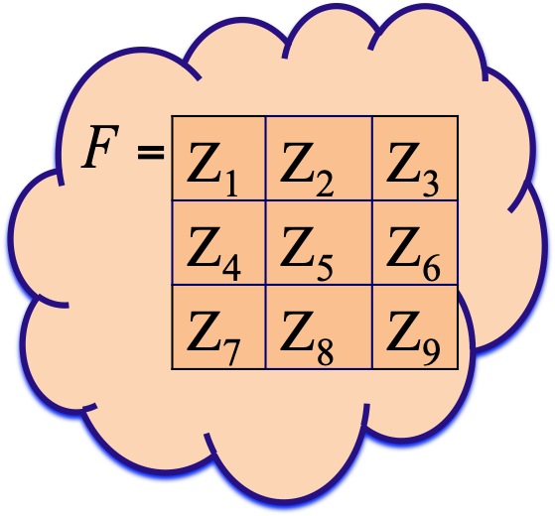
 | Pixel Position | Weight
1 | Center Pixel | 4
2 | 4 Directional Neighbour | 2
3
Kiran TALELE
35

Slide 36
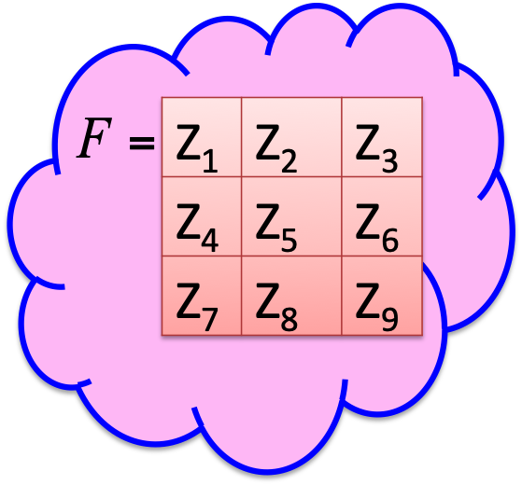
 | Pixel Position | Weight
1 | Center Pixel | 4
2 | 4 Directional Neighbour | 2
3 | Diagonal Direction Neighbour | 1
Kiran TALELE
36

Slide 37
Consider a Digital Image F and filter mask w as shown in fig below,,
F =
A =
Z₁ | Z₂ | Z₃
Z₄ | Z₅ | Z₆
Z₇ | Z₈ | Z₉
Weighted Average Filter
 | 4
Kiran TALELE
37

Slide 38
Consider a Digital Image F and filter mask w as shown in fig below,
F =
A =
Z₁ | Z₂ | Z₃
Z₄ | Z₅ | Z₆
Z₇ | Z₈ | Z₉
Weighted Average Filter
 | 2
2 | 4 | 2
 | 2
Kiran TALELE
38

Slide 39
Consider a Digital Image F and filter mask w as shown in fig below,
F =
A =
Z₁ | Z₂ | Z₃
Z₄ | Z₅ | Z₆
Z₇ | Z₈ | Z₉
Weighted Average Filter
1 | 2 | 1
2 | 4 | 2
1 | 2 | 1
Kiran TALELE
39

Slide 40
Consider a Digital Image F and filter mask w as shown in fig below,
F =
A =
Z₁ | Z₂ | Z₃
Z₄ | Z₅ | Z₆
Z₇ | Z₈ | Z₉
Weighted Average Filter
1 | 2 | 1
2 | 4 | 2
1 | 2 | 1
Kiran TALELE
40

Slide 41
F =
A =
Z₁ | Z₂ | Z₃
Z₄ | Z₅ | Z₆
Z₇ | Z₈ | Z₉
 | R
Weighted Average Filter
1 | 2 | 1
2 | 4 | 2
1 | 2 | 1
The response of mask at A(x,y) position is given by,
R = [( z₁ + 2 z₂ + z₃ )+( 2z₄ + 4 z₅ + 2 z₆ )+ ( z₇ + 2 z₈ + z₉ ) ]
Kiran TALELE
41

Slide 42
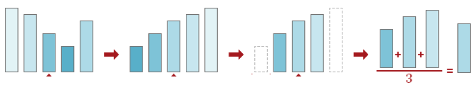
(3) Trimmed Averaging Filter
A non-linear smoothing filter.
This filter deals well with images containing spiky noise, but it is less effective at attenuating random noise
Kiran TALELE
42

Slide 43
Trimmed Mean Filter ALGORITHM :
1. Place a window over element;
2. Pick up elements;
3. Order elements;
Discard elements at the beginning and at the end of the got
ordered set;
Take an average — sum up the remaining elements and
divide the sum by their number.
Since the filter applies a mean to the untrimmed data, it is not edge preserving
Kiran TALELE
43

Slide 44
(4) Alpha (α)-Trimmed Averaging Filter
A non-linear smoothing filter.
For ex. Consider below window size
A =
F =
20 | 20 | 8
21 | 19 | 12
19 | 22 | 10
 | A(x,y)
The ordered list is :
F = { 8, 10, 12, 19, 19, 20, 20, 21, 22}
Kiran TALELE
44

Slide 45
To find A(x,y)
For different values of α, the output is as follows:
Case-1 : When α = 0
F = { 8, 10, 12, 19, 19, 20, 20, 21, 22}
A(x,y) = 18.8
Case-2 : When α = 1
F = { 8, 10, 12, 19, 19, 20, 20, 21, 22}
A(x,y) = 17.3
Kiran TALELE
45

Slide 46
Case-3 : When α = 2
F = { 8, 10, 12, 19, 19, 20, 20, 21, 22}
A(x,y) = 18.0
Case-4 : When α = 3
F = { 8, 10, 12, 19, 19, 20, 20, 21, 22}
A(x,y) = 19.3
Case-5 : When α = 4
F = { 8, 10, 12, 19, 19, 20, 20, 21, 22}
A(x,y) = 19.0
Kiran TALELE
46

Slide 47
This filter is a combination of mean filter and median filter as you said.
This is an algorithmic approach that tries to combine properties of the mean filter with properties of the median filter.
Kiran TALELE
47

Slide 48
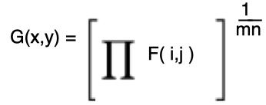
(5) Geometric Mean Filter
The geometric mean filter is an image filtering process meant to smooth and reduce noise of an image.
It is based on the mathematic geometric mean.
The output image G(x,y) of a geometric mean is given by
Kiran TALELE
48

Slide 49
Eg. Consider a digital subimage F
F =
A =
5 | 16 | 22
6 | 3 | 18
12 | 3 | 15
 | A(x,y)
Geometric Mean Filter
The output pixel value at A(x,y) position is given by,
A(x,y) = (5 * 16 * 22 * 6 * 3 * 18 * 12 * 3 * 15)^(1/9)
A(x,y) = 8.77
Kiran TALELE
49

Slide 50
[II] Smoothing Non-Linear Filters [ also called as ordered statistic filters]
(1) Median Filter
(i) Medial filter is a Non-Linear ordered statistic filter.
(ii) Output pixel value at (x,y) position is obtained by selecting the median of neighbourhood of input pixel value.
Kiran TALELE
50

Slide 51
* Median Filter ALGORITHM
(I) Arrange the pixels in the window either in Increasing order OR in Decreasing order.
Select the middle value
If number of pixels in the window are even,
Then find average of the middle two values.
(III) Replace the input pixel value by the selected median value in the output image.
Kiran TALELE
51

Slide 52
Eg. Consider a Digital Image F
F =
41 | 200 | 60
52 | 45 | 72
10 | 58 | 81
A =
 | A(x,y)
Median Filter
1. Arrange All the pixel values in asceding order
10 | 41 | 45 | 52 | 58 | 60 | 72 | 81 | 200
2. Select the middle value
A(x,y) = 58
Kiran TALELE
52

Slide 53
Ex of Digital Image with Salt and Pepper Noise :
F =
41 | 200 | 60
52 | 45 | 42
0 | 58 | 51
Salt Noise Value = 200 (White)
Pepper Noise Value = 0 (Black)
Most of the pixels in the image are in the range
[ 40 to 60 ]
There are two extreme values in the image :
i.e. 200 (Salt Noise) and 0 (Pepper Noise)
Kiran TALELE
53

Slide 54
F =
41 | 200 | 60
52 | 45 | 42
0 | 58 | 51
Median Filter
To remove noisy pixels, assume virtual rows and columns with repeated border pixel values
F =
 | 41 | 200 | 60
 | 52 | 45 | 42
 | 0 | 58 | 51
Kiran TALELE
54

Slide 55
F =
41 | 200 | 60
52 | 45 | 42
0 | 58 | 51
Median Filter
To remove noisy pixels, assume virtual rows and columns with repeated border pixel values
F =
 | 41 | 200 | 60
41 | 41 | 200 | 60 | 60
52 | 52 | 45 | 42 | 42
0 | 0 | 58 | 51 | 51
 | 0 | 58 | 51
Kiran TALELE
55

Slide 56
F =
41 | 200 | 60
52 | 45 | 42
0 | 58 | 51
A =
Median Filter
To remove noisy pixels, assume virtual rows and columns with repeated border pixel values
F =
41 | 41 | 200 | 60 | 60
41 | 41 | 200 | 60 | 60
52 | 52 | 45 | 42 | 42
0 | 0 | 58 | 51 | 51
0 | 0 | 58 | 51 | 51
A =
Median Filter
Kiran TALELE
56

Slide 57
F =
41 | 200 | 60
52 | 45 | 42
0 | 58 | 51
A =
Median Filter
To remove noisy pixels, assume virtual rows and columns with repeated border pixel values
F =
41 | 41 | 200 | 60 | 60
41 | 41 | 200 | 60 | 60
52 | 52 | 45 | 42 | 42
0 | 0 | 58 | 51 | 51
0 | 0 | 58 | 51 | 51
A =
Median Filter
Kiran TALELE
57

Slide 58
F =
41 | 200 | 60
52 | 45 | 42
0 | 58 | 51
A =
Median Filter
To remove noisy pixels, assume virtual rows and columns with repeated border pixel values
F =
41 | 41 | 200 | 60 | 60
41 | 41 | 200 | 60 | 60
52 | 52 | 45 | 42 | 42
0 | 0 | 58 | 51 | 51
0 | 0 | 58 | 51 | 51
A =
Median Filter
51
Kiran TALELE
58

Slide 59
F =
41 | 200 | 60
52 | 45 | 42
0 | 58 | 51
A =
Median Filter
To remove noisy pixels, assume virtual rows and columns with repeated border pixel values
F =
41 | 41 | 200 | 60 | 60
41 | 41 | 200 | 60 | 60
52 | 52 | 45 | 42 | 42
0 | 0 | 58 | 51 | 51
0 | 0 | 58 | 51 | 51
A =
45
Median Filter
Kiran TALELE
59

Slide 60
F =
41 | 200 | 60
52 | 45 | 42
0 | 58 | 51
A =
Median Filter
To remove noisy pixels, assume virtual rows and columns with repeated border pixel values
F =
41 | 41 | 200 | 60 | 60
41 | 41 | 200 | 60 | 60
52 | 52 | 45 | 42 | 42
0 | 0 | 58 | 51 | 51
0 | 0 | 58 | 51 | 51
A =
45
52
Median Filter
Kiran TALELE
60

Slide 61
F =
41 | 200 | 60
52 | 45 | 42
0 | 58 | 51
A =
Median Filter
To remove noisy pixels, assume virtual rows and columns with repeated border pixel values
F =
41 | 41 | 200 | 60 | 60
41 | 41 | 200 | 60 | 60
52 | 52 | 45 | 42 | 42
0 | 0 | 58 | 51 | 51
0 | 0 | 58 | 51 | 51
A =
45 | 52
60
Median Filter
Kiran TALELE
61

Slide 62
F =
41 | 200 | 60
52 | 45 | 42
0 | 58 | 51
A =
Median Filter
To remove noisy pixels, assume virtual rows and columns with repeated border pixel values
F =
41 | 41 | 200 | 60 | 60
41 | 41 | 200 | 60 | 60
52 | 52 | 45 | 42 | 42
0 | 0 | 58 | 51 | 51
0 | 0 | 58 | 51 | 51
A =
45 | 52 | 60
Median Filter
45
Kiran TALELE
62

Slide 63
F =
41 | 200 | 60
52 | 45 | 42
0 | 58 | 51
A =
Median Filter
To remove noisy pixels, assume virtual rows and columns with repeated border pixel values
F =
41 | 41 | 200 | 60 | 60
41 | 41 | 200 | 60 | 60
52 | 52 | 45 | 42 | 42
0 | 0 | 58 | 51 | 51
0 | 0 | 58 | 51 | 51
A =
45 | 52 | 60
45
Median Filter
51
Kiran TALELE
63

Slide 64
F =
41 | 200 | 60
52 | 45 | 42
0 | 58 | 51
A =
Median Filter
To remove noisy pixels, assume virtual rows and columns with repeated border pixel values
F =
41 | 41 | 200 | 60 | 60
41 | 41 | 200 | 60 | 60
52 | 52 | 45 | 42 | 42
0 | 0 | 58 | 51 | 51
0 | 0 | 58 | 51 | 51
A =
45 | 52 | 60
45 | 51
Median Filter
51
Kiran TALELE
64

Slide 65
F =
41 | 200 | 60
52 | 45 | 42
0 | 58 | 51
A =
Median Filter
To remove noisy pixels, assume virtual rows and columns with repeated border pixel values
F =
41 | 41 | 200 | 60 | 60
41 | 41 | 200 | 60 | 60
52 | 52 | 45 | 42 | 42
0 | 0 | 58 | 51 | 51
0 | 0 | 58 | 51 | 51
A =
45 | 52 | 60
45 | 51 | 51
Median Filter
45
Kiran TALELE
65

Slide 66
F =
41 | 200 | 60
52 | 45 | 42
0 | 58 | 51
A =
Median Filter
To remove noisy pixels, assume virtual rows and columns with repeated border pixel values
F =
41 | 41 | 200 | 60 | 60
41 | 41 | 200 | 60 | 60
52 | 52 | 45 | 42 | 42
0 | 0 | 58 | 51 | 51
0 | 0 | 58 | 51 | 51
A =
45 | 52 | 60
45 | 51 | 51
Median Filter
45
51
Kiran TALELE
66

Slide 67
F =
41 | 200 | 60
52 | 45 | 42
0 | 58 | 51
A =
Median Filter
To remove noisy pixels, assume virtual rows and columns with repeated border pixel values
F =
41 | 41 | 200 | 60 | 60
41 | 41 | 200 | 60 | 60
52 | 52 | 45 | 42 | 42
0 | 0 | 58 | 51 | 51
0 | 0 | 58 | 51 | 51
A =
45 | 52 | 60
45 | 51 | 51
Median Filter
45
51
51
Kiran TALELE
67

Slide 68
F =
41 | 200 | 60
52 | 45 | 42
0 | 58 | 51
A =
Median Filter
To remove noisy pixels, assume virtual rows and columns with repeated border pixel values
F =
41 | 41 | 200 | 60 | 60
41 | 41 | 200 | 60 | 60
52 | 52 | 45 | 42 | 42
0 | 0 | 58 | 51 | 51
0 | 0 | 58 | 51 | 51
A =
45 | 52 | 60
45 | 51 | 51
45 | 51 | 51
Median Filter
Kiran TALELE
68

Slide 69
F =
41 | 200 | 60
52 | 45 | 42
0 | 58 | 51
A =
Median Filter
To remove noisy pixels, assume virtual rows and columns with repeated border pixel values
F =
 | 41 | 200 | 60
 | 52 | 45 | 42
 | 0 | 58 | 51
A =
45 | 52 | 60
45 | 51 | 51
45 | 51 | 51
Median Filter
Kiran TALELE
69

Slide 70
F =
41 | 200 | 60
52 | 45 | 42
0 | 58 | 51
A =
45 | 52 | 60
45 | 51 | 51
45 | 51 | 51
Median Filter
Input image
with Salt and
Pepper Noise
Median Filtered
output image with eliminated
Salt and Pepper Noise values
Kiran TALELE
70

Slide 71
Median Filter forces the points with distinct gray levels to be more like their neighbours
F =
41 | 200 | 60
52 | 45 | 42
0 | 58 | 51
When all the pixel values are arranged in order, distinct values occupy extreme positions and Median filter selects median i.e. middle vales of ordered pixel values.
Therefore, noisy pixel values are eliminated median filter
A =
45 | 52 | 60
45 | 51 | 51
45 | 51 | 51
Kiran TALELE
71

Slide 72
F =
41 | 200 | 60
52 | 45 | 42
0 | 58 | 51
Eliminated noisy pixel values are replaced by one of the neighbouring pixel values.
A =
45 | 52 | 60
45 | 51 | 51
45 | 51 | 51
Therefore, Median Filter is the most suitable to remove Salt and Pepper Noise in the image.
Kiran TALELE
72

Slide 73
(2) Max Filter
(i) Max filter is a Non-Linear ordered statistic filter.
(ii) Output pixel value at (x,y) position is obtained by selecting the Maximum of neighbourhood of input pixel value.
(3) Min Filter
(i) Min filter is a Non-Linear ordered statistic filter.
(ii) Output pixel value at (x,y) position is obtained by selecting the Minimum of neighbourhood of input pixel value.
Kiran TALELE
73

Slide 74
Eg.
F =
41 | 200 | 60
52 | 45 | 42
0 | 58 | 51
A =
Max Filter
200
F =
41 | 200 | 60
52 | 45 | 42
0 | 58 | 51
A =
Min Filter
0
Kiran TALELE
74

Slide 75
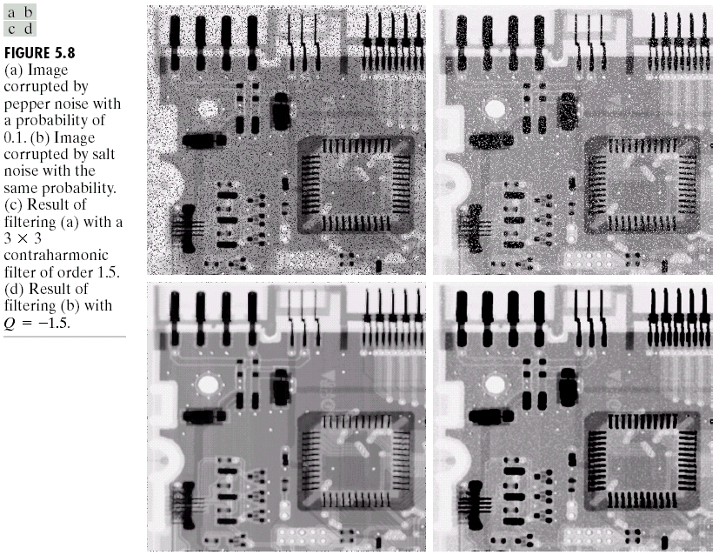
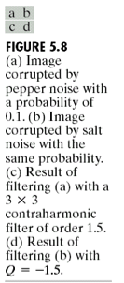
Kiran TALELE
75

Slide 76
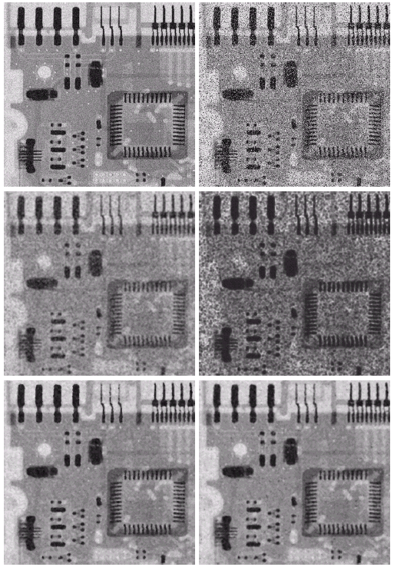
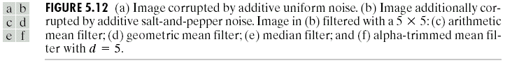

Slide 77
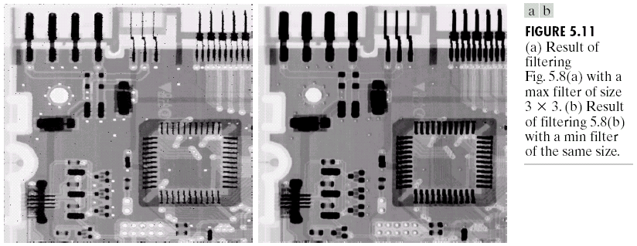
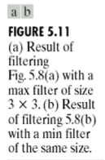
Result :
Kiran TALELE
77

Slide 78
Sharpening Derivative Filters
Concept :
Smoothing
Filter
SUM
Integration
Ex. LPF
Sharpening
Filter
Differentiation
Difference
Ex. HPF
Kiran TALELE
78

Slide 79
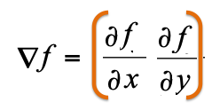
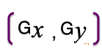
[ III ] Sharpening First Order Derivative filters [also called as Gradient Filters]
Eg: Robert, Prewit, Sobel and Fri-chen filters
Method of differentiation is Gradient
The Gradient of F at (x,y) position is defined as,
Kiran TALELE
79

Slide 80
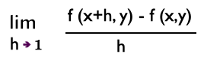
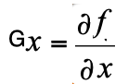
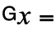
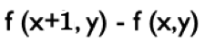
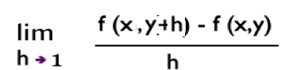
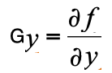
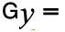
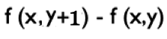
Where,
Kiran TALELE
80

Slide 81

y-1
y
y+1
F =
 | f(x-1,y)
f(x,y-1) | f(x,y) | f(x,y+1)
 | f(x+1,y)
x-1
x
x+1
Kiran TALELE
81

Slide 82
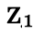
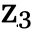
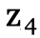
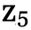
y
F =
Robert Filter
( 1st Order Derivative Sharpening filter )
x
To find Gx
To find Gy
-
-
-1
0
-1 1
1
0
0 0
Kiran TALELE
82

Slide 83
y
2. Prewit Filter
( 1st Order Derivative - Sharpening filter )
z₁ | z₂ | z₃
z₄ | z₅ | z₆
z₇ | z₈ | z₉
x
To find Gx
To find Gy
Gx= (z₇–z₁)+(z₈–z₂)+ (z₉–z₃)
Gx= (z₃–z₁)+(z₆–z₄)+ (z₉–z₇)
-1 -1 -1
-1 0 1
0 0 0
-1 0 1
1 1 1
-1 0 1
Kiran TALELE
83

Slide 84
y
3. Sobel Filter
( 1st Order Derivative - Sharpening filter )
z₁ | z₂ | z₃
z₄ | z₅ | z₆
z₇ | z₈ | z₉
x
To find Gx
To find Gy
Gx= (z₇–z₁) +2 (z₈–z₂) + (z₉–z₃)
Gy= (z₃–z₁)+ 2 (z₆–z₄) + (z₉–z₇)
-1 -2 -1
-1 0 1
0 0 0
-2 0 2
1 2 1
-1 0 1
Kiran TALELE
84

Slide 85
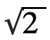
y
4. Fri-Chen Filter
( 1st Order Derivative - Sharpening filter )
z₁ | z₂ | z₃
z₄ | z₅ | z₆
z₇ | z₈ | z₉
x
To find Gx
To find Gy
Gx= (z₇–z₁) + (z₈–z₂)+(z₉–z₃)
Gy= (z₃–z₁)+ (z₆–z₄)+ (z₉–z₇)
-1 - - 1
-1 0 1
0 0 0
- 0
1 1
-1 0 1
Kiran TALELE
85

Slide 86
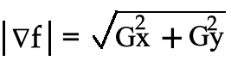
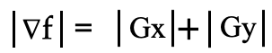
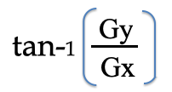
1. The Magnitude of Gradient at (x,y) is given by,
2. Orientation at (x,y) is given by,
α =
Kiran TALELE
86

Slide 87
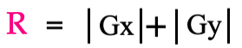
3. To find response of the Gradient filter,
F =
z₁ | z₂ | z₃
z₄ | z₅ | z₆
z₇ | z₈ | z₉
A =
Gradient
Filter
R
where,
Kiran TALELE
87

Slide 88
Example-1 :
F =
41 | 200 | 60
52 | 45 | 42
0 | 58 | 51
Prewit Gradient
Filter
A =
R
Prewit Vertical Mask is given by,
(i) To find Gx
Gx = (-41) + (-142) + (-9)
-1 -1 -1
Gx = -192
0 0 0
1 1 1
Kiran TALELE
88

Slide 89
Similarly,
F =
41 | 200 | 60
52 | 45 | 42
0 | 58 | 51
Prewit Gradient
Filter
A =
R
Prewit Horizontal Mask is given by,
(ii) To find Gy
Gy = (19) + (-10) + (51)
-1 0 1
Gx = 60
-1 0 1
-1 0 1
Kiran TALELE
89

Slide 90
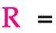
Example...
F =
41 | 200 | 60
52 | 45 | 42
0 | 58 | 51
Prewit Gradient
Filter
A =
R
(iii) To find R
( 192 ) + ( 60 )
( 252 )
Kiran TALELE
90

Slide 91
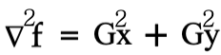
[IV] Second Order Derivative filters Eg. Laplacian Filter, HPF and High Boost Filter
(2) Laplacian Filter
The Laplacian filter is Second Order Derivative filter
The Laplacian of Digital image f at (x,y) position is given by,
Kiran TALELE
91

Slide 92
y-1 y y+1
(i) Find G²x
x-1
 | f(x-1,y)
f(x,y-1) | f(x,y) | f(x,y+1)
 | f(x+1,y)
x
Gx = f(x+1,y) - f(x,y)
x+1
G²x = [ f(x+1,y) - f(x,y)] – [ f(x,y) - f(x-1,y )]
G²x = f(x+1,y) – 2 f(x,y) + f(x-1,y )
G²x =
0 | 1 | 0
0 | -2 | 0
0 | 1 | 0
G²x =
0 | - 1 | 0
0 | 2 | 0
0 | - 1 | 0
Scale by (-1)
Kiran TALELE
92

Slide 93
y-1 y y+1
(i) Find G²y
x-1
 | f(x-1,y)
f(x,y-1) | f(x,y) | f(x,y+1)
 | f(x+1,y)
x
Gy = f(x, y+1) - f(x,y)
x+1
G²y = [ f(x, y+1) - f(x,y)] – [ f(x,y) - f(x, y-1 )]
G²y = f(x, y+1) – 2 f(x,y) + f(x, y-1)
G²y =
0 | 0 | 0
1 | -2 | 1
0 | 0 | 0
G²y =
0 | 0 | 0
-1 | 2 | -1
0 | 0 | 0
Scale by (-1)
Kiran TALELE
93

Slide 94
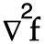
y-1 y y+1
(iii) Find
x-1
 | f(x-1,y)
f(x,y-1) | f(x,y) | f(x,y+1)
 | f(x+1,y)
x
x+1
=
0 | 1 | 0
0 | 2 | 0
0 | -1 | 0
0 | 0 | 0
-1 | 2 | -1
0 | 0 | 0
+
=
0 | -1 | 0
-1 | 4 | -1
0 | -1 | 0
Laplacian 4 directional Mask
Kiran TALELE
94

Slide 95
(iv) Find
=
+
( 4 Directional)
( Diagonal Directional)
=
0 | -1 | 0
-1 | 4 | -1
0 | -1 | 0
-1 | 0 | -1
0 | 4 | 0
-1 | 0 | -1
+
=
-1 | -1 | -1
-1 | 8 | -1
-1 | -1 | -1
Laplacian 8 directional Mask
Kiran TALELE
95

Slide 96
(2) High Pass Filter
(i) HPF attenuates LOW frequency Components and allows to pass HIGH frequency components of the image.
(ii) HPF image can be obtained by subtracting LPF image from the original image.
HPF Mask is given by,
w =
-1 | -1 | -1
-1 | 8 | -1
-1 | -1 | -1
Kiran TALELE
96

Slide 97
Eg. Consider a Digital Image F as given below
10 | 10 | 200 | 200
10 | 10 | 200 | 200
10 | 10 | 200 | 200
10 | 10 | 100 | 100
10 | 10 | 100 | 100
10 | 10 | 100 | 100
H P F
0 | 30 | 30 | 0
0 | 30 | 30 | 0
0 | 30 | 30 | 0
100 | 100
100 | 100
100 | 100
-1 | -1 | -1
-1 | 8 | -1
-1 | -1 | -1
W=
10 | 10 | 10 | 100 | 100 | 100
10 | 10 | 10 | 100 | 100 | 100
10 | 10 | 10 | 100 | 100 | 100
10 | 10 | 10 | 100 | 100 | 100
10 | 10 | 10 | 100 | 100 | 100
 | 0 | 30 | 30 | 0
 | 0 | 30 | 30 | 0
 | 0 | 30 | 30 | 0
Kiran TALELE
97

Slide 98
NOTE :
Original Image = LPF Image + HPF Image
Kiran TALELE
98

Slide 99
Derivation of HPF Mask
Consider a Digital Image F and HPF Mask w as shown in figure below,
Z₁ | Z₂ | Z₃
Z₄ | Z₅ | Z₆
Z₇ | Z₈ | Z₉
L P F
 | A(x,y)
The response of HPF mask at A(x,y) position is given by,
A(x,y) = z₁ w₁ + z₂ w₂ + z₃ w₃ + … + z₉ w₉ ……(I)
Kiran TALELE
99

Slide 100
Consider a Digital Image F and LPF Mask w as shown in figure below,
Z₁ | Z₂ | Z₃
Z₄ | Z₅ | Z₆
Z₇ | Z₈ | Z₉
L P F
 | B(x,y)
w =
1 | 1 | 1
1 | 1 | 1
1 | 1 | 1
The response of LPF mask at B(x,y) position is given by,
B(x,y) = z₁ z₁ + z₂ + + … + z₉ …… (II)
Kiran TALELE
100

Slide 101
Now,
Original Image = LPF Image + HPF Image
HPF Image = Original Image - LPF Image
=
-
 | A(x,y)
Z₁ | Z₂ | Z₃
Z₄ | Z₅ | Z₆
Z₇ | Z₈ | Z₉
 | B(x,y)
At (x,y) position,
A(x,y) = Z₅ - B(x,y)
Kiran TALELE
101

Slide 102
Now, A(x,y) = Z₅ - B(x,y)
Where, B(x,y) = z₁ z₁ + z₂ + + … + z₉
A(x,y) = Z₅ – ( z₁ + z₂ + + … + z₉ )
= Z₅ - z₁ - z₂ - z₃ - z₄ - z₅ … z₉ )
A(x,y) = - z₁ – z₂ - z₃ - z₄ + z_{5 …}- z_{9..}) ----(III)
Kiran TALELE
102

Slide 103
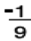
A(x,y) = z₁ w₁ + z₂ w₂ + z₃ w₃ + … + z₉ w₉ ……(I)
A(x,y) = - z₁ – z₂ - z₃ - z₄ + z_{5 …}- z_{9..}) ----(III)
By equating equation (I) and (III) we get,
w =
w₁= | w₂= | w₃=
w₄= | w₅= | w₆=
w₇= | w₈= | W₉ =
w =
-1 | -1 | -1
-1 | 8 | -1
-1 | -1 | -1
Kiran TALELE
103

Slide 104
High Boost Filter (HBF) Image is obtained by adding HPF image with the original Image.
(3) High Boost Filter
HBF Image = Original Image + HPF Image
=
+
 | A(x,y)
Z₁ | Z₂ | Z₃
Z₄ | Z₅ | Z₆
Z₇ | Z₈ | Z₉
 | B(x,y)
At (x,y) position,
A(x,y) = Z₅ + B(x,y)
Kiran TALELE
104

Slide 105
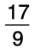
Now, A(x,y) = Z₅ + B(x,y)
Where, B(x,y)
= - z₁ - z₂ - z₃ - z₄ - z₅ … - z₉ )
By Substituting,
A(x,y) =
= Z₅ - z₁ - z₂ - z₃ - z₄ + z₅ … - z₉ )
A(x,y) =
- z₁ - z₂ - z₃ - z₄ + z₅ … - z₉ )
Kiran TALELE
105

Slide 106
A(x,y) =
- z₁ - z₂ - z₃ - z₄ + z₅ … - z₉ )
Let A(x,y) = z₁ w₁ + z₂ w₂ + z₃ w₃ + … + z₉ w₉
By equating, HBF Mask is then given by,
w =
w₁= | w₂= | w₃=
w₄= | w₅= | w₆=
w₇= | w₈= | W₉ =
w =
-1 | -1 | -1
-1 | 17 | -1
-1 | -1 | -1
Kiran TALELE
106

Slide 107




Dr. Kiran TALELE
Academic : PhD
Professional :
Dean-Students, Alumni & External Relations @ Bharatiya Vidya Bhavans’ Sardar Patel Institute of Technology (SP-IT), Mumbai
Head-Academic Relation @ Sardar Patel Technology Business Incubator (SP-TBI), Mumbai
Treasurer-IEEE Bombay Section
091-9987030881
kiran.talele@spit.ac.in / ktvtalele@gmail.com
https://www.linkedin.com/in/k-t-v-talele/
www.facebook.com/Kiran-Talele-1711929555720263
Stay Connected
107
107

Slide 108
Dr. Kiran TALELE is an Associate Professor in Electronics & Telecommunication Engineering Department of Bharatiya Vidya Bhavans’ Sardar Patel Institute of Technology, Mumbai with 33+ years experience in Academics.
He is a Dean of Students, Alumni and External Relations at Sardar Patel Institute of Technology, Andheri Mumbai.
He is also a Head of Sardar Patel Technology Business Incubator, Mumbai.
His area of research is Digital Signal & Image Processing, Computer Vision, Machine Learning and Multimedia System Design.
He has published 85+ research papers at various national & international refereed conferences and journals. He has filed published 25+ patents at Indian Patent Office. One patent is granted in 2021.
He is a Treasurer of IEEE Bombay Section and Mentor for Startup Incubation & Intellectual Asset Creation.
He is a recipient of P.R. Bapat IEEE Bombay Section Outstanding Volunteer Award 2019.

